Slide 1

Fine-Tuning LLAMA3 Language Model
Ali BeSHER

Slide 2
This project provides practical hands-on experience in fine-tuning Meta's LLAMA3 large language model on local and cloud-based environments. The objective is to equip students with skills in NLP, deep learning, model customization, and deployment for real-world tasks, with a special focus on healthcare applications.
Executive Summary

Slide 3
With the growing significance of LLMs in areas such as chat applications and medical diagnostics, this project introduces students to:
Customizing LLMs for domain-specific use-cases
Evaluating model performance effectively
Using state-of-the-art tools for local and cloud-based deployment
Motivation

Slide 4
In our project, we are not starting from scratch to build a language model. Instead, we begin with one of today’s best open-source LLMs. After much thought, we choose: Llama 3-8B-Instruct-bnb-4bit. A large AI model contains millions of digital “strings”. However, it needs careful tuning and customization to achieve its best performance for a specific task. This is where fine-tuning comes in: It’s like retuning a wonderful instrument. The base model has huge potential, but unless its abilities are directed and finely adjusted for your domain or data, its performance will remain general and suboptimal. With fine-tuning, we “turn the knobs” of the model and refine its inner details until we reach the high-quality performance for the type of dialogue or field we’re targeting. That’s why we didn’t choose a giant model that would exhaust our resources, nor a tiny model that lacks creativity. Instead, we found the smart balance in Llama-3-8B (bnb-4bit), leveraging the best fast and efficient training techniques (LoRA and Unsloth), to get the best mix for limited time and compute.
Fine-Tuning

Slide 5
We were faced with an infinite amount of data. But after filtering and focusing on quality, we decided the best option was to use FineTome-100k. Still, we had two choices: either use the full 100,000-sample dataset, or just a subset. At first, using all the data, the more data, the more chances for the model to learn. But in reality, running on Google Colab (even with an A100 GPU), loading all the data at once made training noticeably slower, and could even destabilize the session. We tried reducing the size to 20,000 examples; training was much faster and results were fairly satisfying (we reached a 0.79 training loss and 0.84 validation loss). Still, we noticed a tendency toward overfitting. So, after several trials, we found that selecting 50,000 well-chosen samples (specifically, after filtering out very short dialogues) gave the best balance between data diversity, training speed, and not exceeding Colab’s memory limits. Filtering out dialogues shorter than 100 tokens wasn’t random — it was based on observation and research into expert advice online. Longer dialogues generally provide deeper context for the model and reduce the risk of “rote memorization” or learning from shallow examples.
Data Selection & Filtering: Quality over Quantity

Slide 6
Results and Graphs of the Preliminary Model
RSULTS & GRAPHS

Slide 7
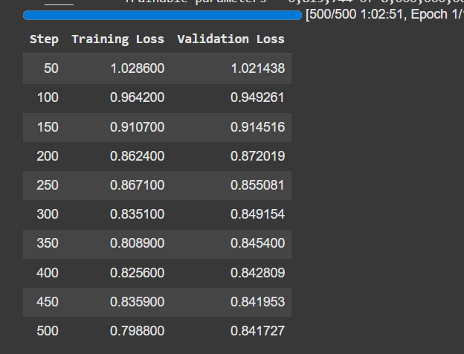
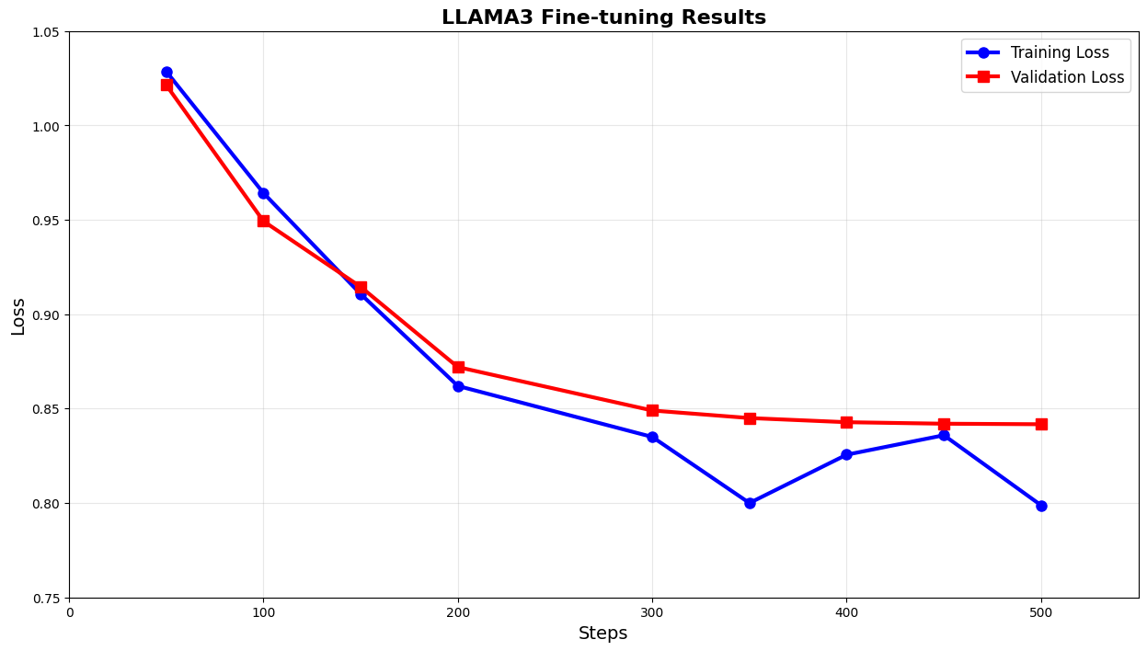

Slide 8
- Small dataset size → Limited generalizat
- Short sentences may not capture complexity.
- Lower step count may limit learning.
- Fluctuations in loss.
Preliminary Model Summary

Slide 9
Results and Graphs of the Final Model
RSULTS & GRAPHS

Slide 10
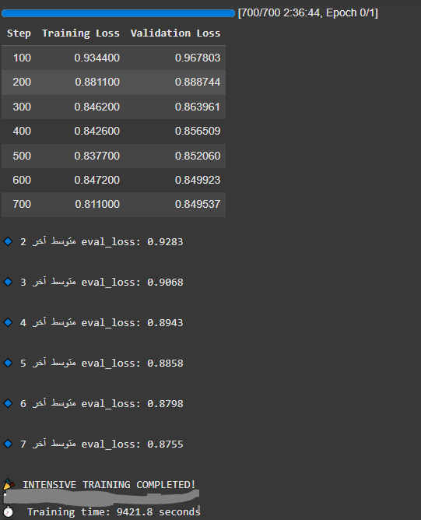
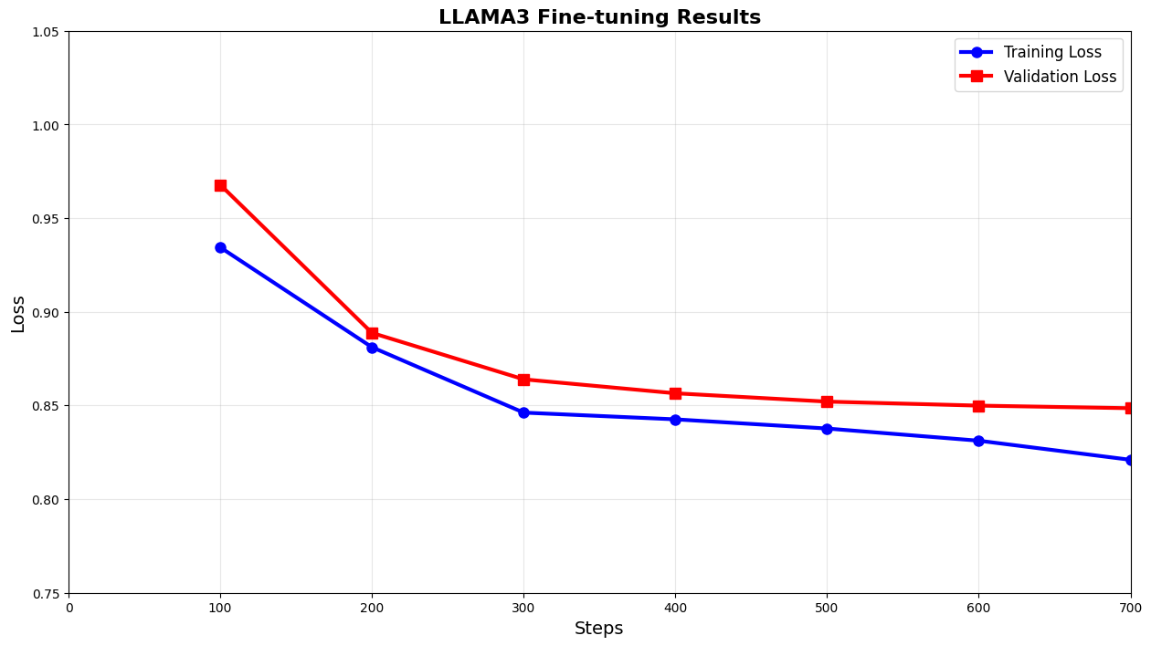

Slide 11
- Larger, richer dataset improves learning.
- Long sentences provide deeper context.
- Higher steps allow more learning iterations.
- Loss consistently decreases and stabilizes.
- Better model generalization expected.
Final Model Summary

Slide 12
Every training setting was chosen based on experimentation.
•We used a very small batch size (2) with gradient accumulation (8), not just because of limited memory, but because this lets us simulate a relatively large batch size (16), which helps stabilize the loss and improve results without hitting Google Colab limits or OOM errors.
•Our learning rate (1e-4) wasn’t random — we found that higher rates speed up training but made validation loss jump suddenly, while lower rates made training impractically slow. This value was the “golden point” for our model and data after several short training cycles.
•We chose 700 max_steps after watching the learning curve: increasing steps further gave diminishing returns and increased overfitting risk or wasted time/resources. Noticing this, we exploited the fact that further training yielded less benefit.
•We picked Cosine Scheduler because it proved effective at making the model learn rapidly at first, then slow down and stabilize at the end — resulting in the best validation accuracy.
Training Configuration - Parameter

Slide 13
After reviewing NVIDIA’s official documentation and Ampere architecture whitepaper, we compared fp16, fp32, and bf16 for our AI model training. We found that bf16, as recommended for the A100 GPU, combines the high speed of fp16 with the numerical safety of fp32, making it the most efficient and reliable choice for large-scale deep learning.
NVIDIA Corporation. "NVIDIA A100 Tensor Core GPU Architecture. “PAGE (9)" https://images.nvidia.com/aem-dam/en-zz/Solutions/data-center/nvidia-ampere-architecture-whitepaper.pdf
Picking gpu

Slide 14
Given the limited session time and the risk of losing files from /content/ in Colab, regular checkpointing (every 200 steps) and downloading the best model at the end became essential.
We also made sure to move final models/files to Google Drive immediately after training, to avoid losing hours of work due to a simple error or session timeout — which happened to us many times before.
Saving & Checkpointing

Slide 15
Our project isn’t just about applying modern techniques; it’s an example of smart decision engineering:
•We balanced scientific ambition with technical reality.
•We tested and tried every option based on evidence, not just theory.
•Every setting here is a practical lesson in turning obstacles into opportunities, and finding a middle ground that achieves the best results at the lowest cost.
Methodology Recap

Slide 16
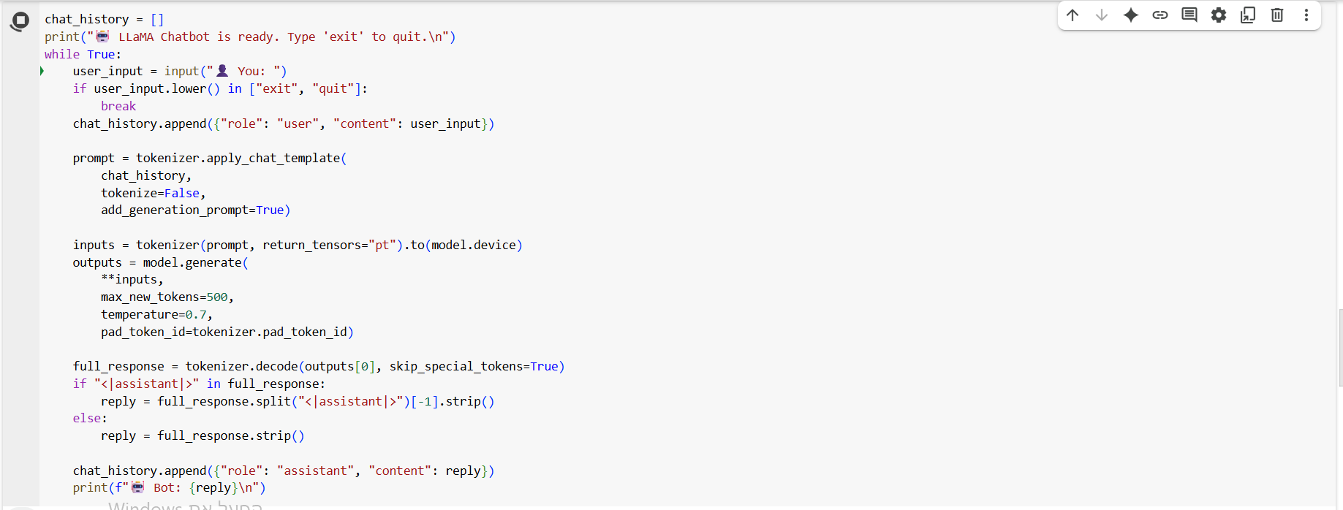

Slide 17
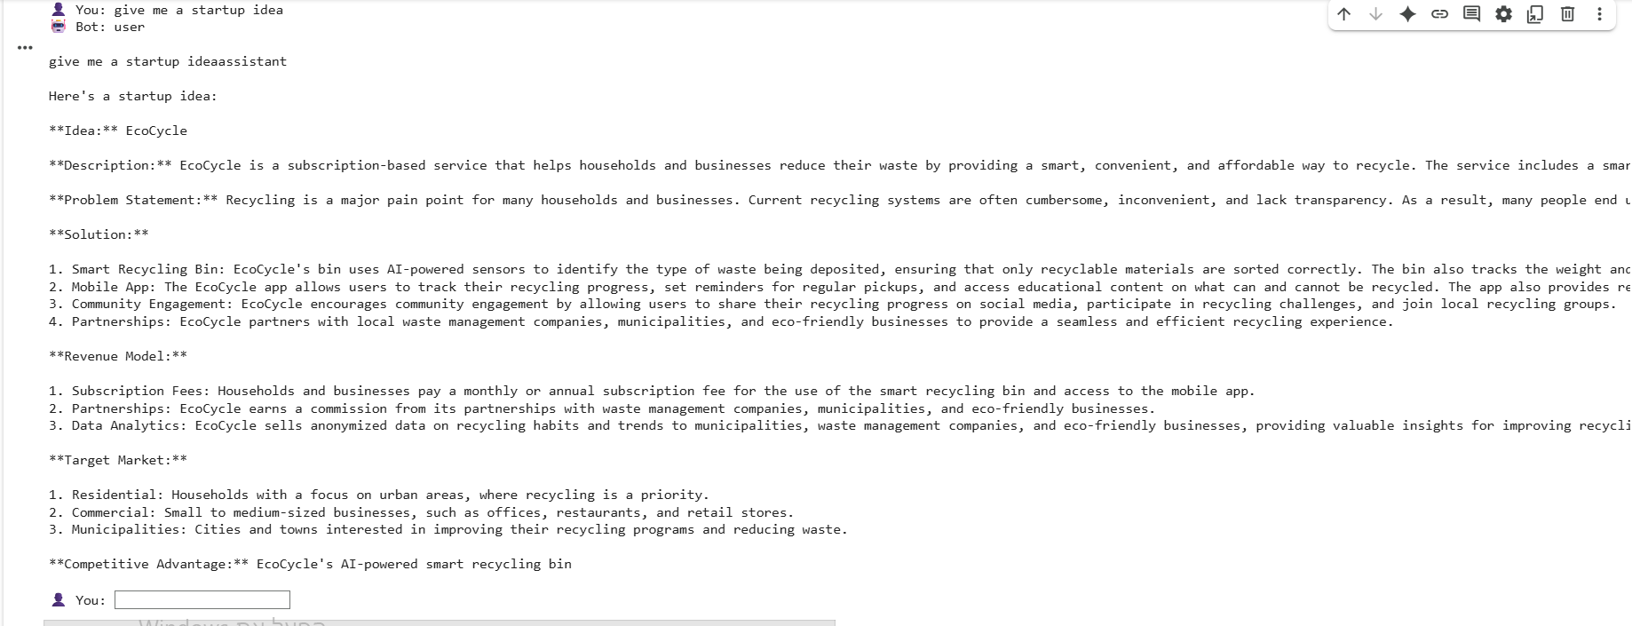

Slide 18
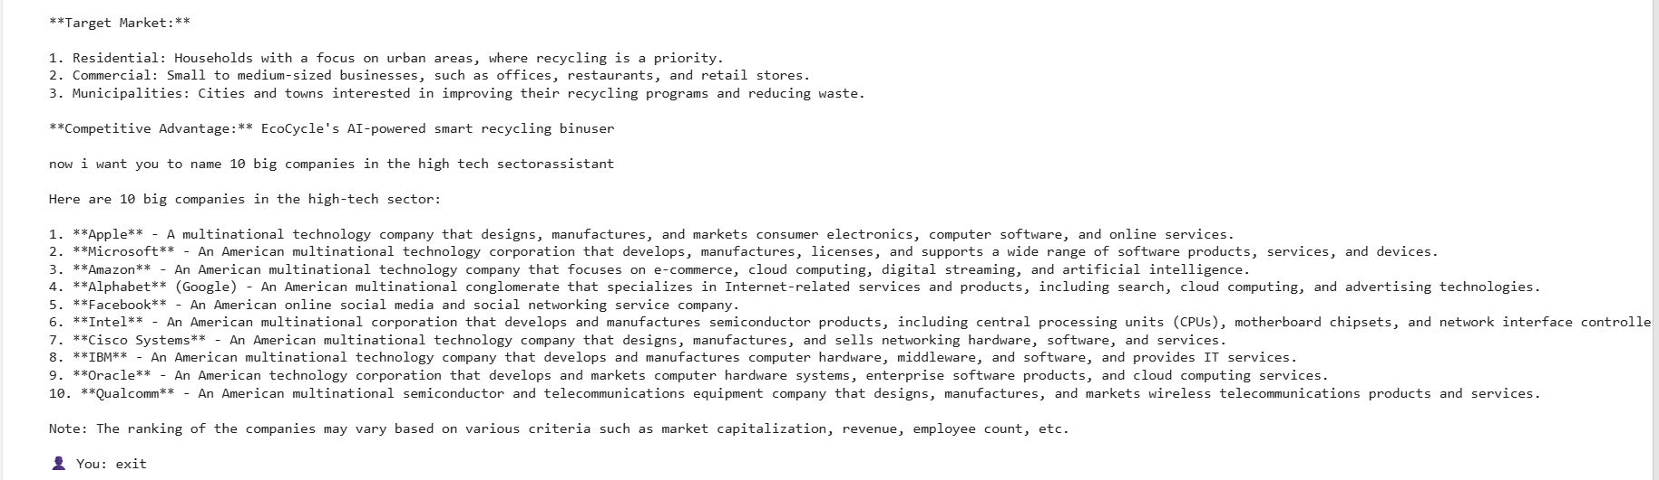

Slide 19
Let's Try a Live Experiment ...

